Slide 1
Methods to study 3D structure and 3d structure prediction.
Presented by KUNAL

Slide 2
Methods to study 3D structure
X-ray crystallography was founded by Menzer (The application of X-ray crystallography to mineralogy began with the structure of garnet)
DNA - Rosalind Franklin
Protein- John Kendrew and Max Perutz (the first protein structure (myoglobin))

Slide 3
Why is structural biology important?
Structural biology is a field focused on understanding biological macromolecules such as proteins and RNAs. Deciphering the effects of changes to the structure of these biological macromolecules helps elucidate their function and the part they play in diseases.

Slide 4
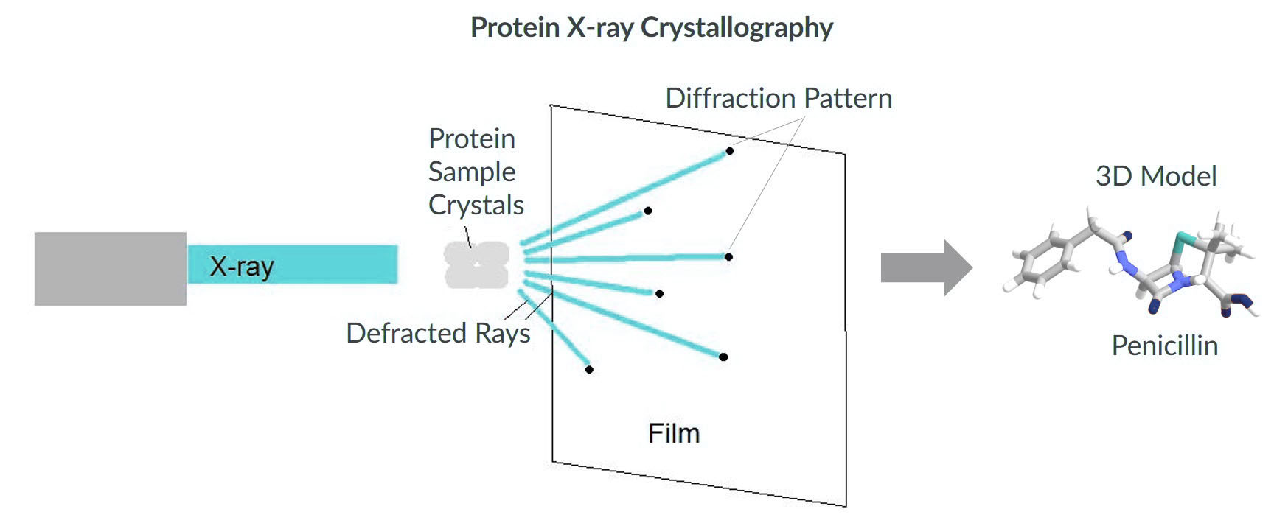
X-ray crystallography
X-ray crystallography has been used to find the structure and function of many biological molecules, including vitamins, drugs, proteins and nucleic acids such as DNA.

Slide 5
X-ray crystallography
a technique used for determining the atomic and molecular structure of a crystal in which the crystalline structure cause a beam of incident X-rays to diffract into many specific directions.
By measuring the angles and intensities of these diffracted beams, a crystallographer can produce a three dimensional picture of the density of electrons within the crystal.
From this electron density, the mean positions of the atoms in the crystal can be determined, as well as their chemical bonds, their crystallographic disorder, and various other information

Slide 6
Steps of X-ray crystallography
Crystallization: The first—and often most difficult—step is to obtain an adequate crystal of the material under study. The crystal should be sufficiently large (typically larger than 0.1 mm in all dimensions), pure in composition and regular in structure, with no significant internal imperfections such as cracks or twinning.
X-ray Diffraction: In the second step, the crystal is placed in an intense beam of X-rays usually of a single wavelength producing the regular pattern of reflections. The angles and intensities of diffracted X-rays are measured, with each compound having a unique diffraction pattern. As the crystal is gradually rotated, previous reflections disappear, and new ones appear; the intensity of every spot is recorded at every orientation of the crystal. Multiple data sets may have to be collected, with each set covering slightly more than half a full rotation of the crystal and typically containing tens of thousands of reflections. Reflections can be recorded on a photographic film, an area detector or with a charge couple device (CCD) image sensor.
Preparation of electron density map and model refinement: In the third step, these data are combined computationally with complementary chemical information to produce and refine a model of the arrangement of atoms within the crystal. The final, refined model of the atomic arrangement—now called a crystal structure—is usually stored in a public database.

Slide 7
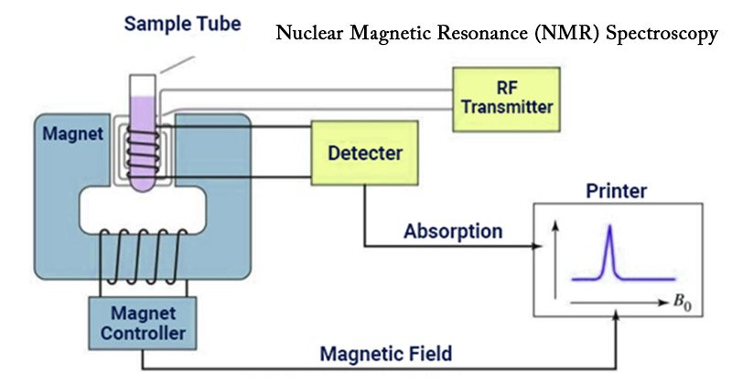
Nuclear Magnetic Resonance (NMR) Spectroscopy
is a spectroscopic technique to observe local magnetic fields around atomic nuclei.
The sample is placed in a magnetic field and the NMR signal is produced by excitation of the nuclei sample with radio waves into nuclear magnetic resonance, which is detected with sensitive radio receivers.

Slide 8
Principle of Nuclear Magnetic Resonance (NMR) Spectroscopy
NMR spectroscopy is based on the phenomenon of Nuclear Magnetic Resonance (NMR). results from specific magnetic properties of certain atomic nuclei. The principle behind NMR is that many nuclei have spin and are electrically charged. If an external magnetic field is applied, an energy transfer is possible between the base energy to a higher energy level (generally a single energy gap). The energy transfer takes place at a wavelength that corresponds to radio frequencies and when the spin returns to its base level, energy is emitted at the same frequency. The signal that matches this transfer is measured in many ways and processed in order to yield an NMR spectrum for the nucleus concerned.

Slide 9
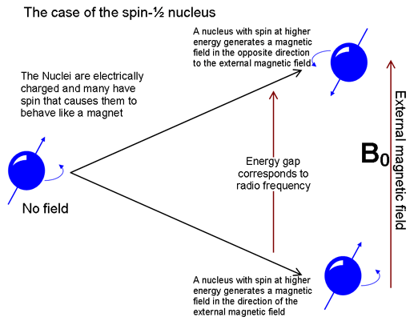

Slide 10
NMR spectroscopy of Biomolecules
Proteins
Carbohydrates
Nucleic acids

Slide 11
SECONDARY STRUCTURE PREDICTION FOR GLOBULAR PROTEINS
Methods
1. Ab Initio–Based Methods | Knowledge | Single query sequence | Chou-Fasman and Garnier, Osguthorpe, Robson (GOR) methods
2. Homology-Based Methods | Ab initio + multiple homologous sequence | Multiple query sequence
3. Prediction with Neural Networks | Machine learning (first trained with known structure) |  | PHD, PSIRED, SSpro Web-based program

Slide 12
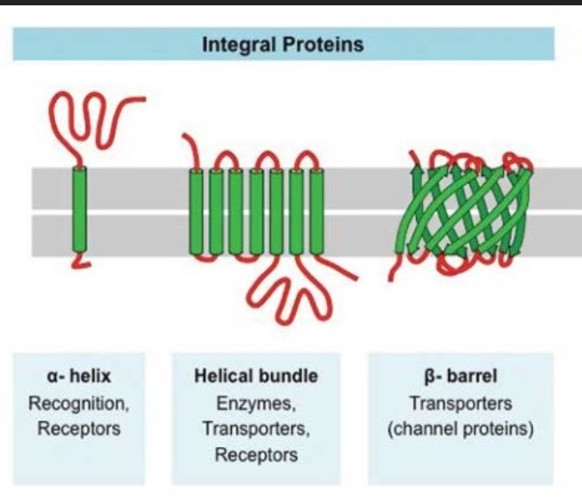
SECONDARY STRUCTURE PREDICTION FOR TRANSMEMBRANE PROTEINS
Transmembrane proteins constitute up to 30% of all cellular proteins.
Important functions- signal transduction, cross-membrane transport, and energy conversion
There are two types of integral membrane proteins: α-helical type and β-barrel type.

Slide 13
Methods for 3D structure prediction
1953 - Watson & Crick proposed the double helix model for DNA based x-ray data obtained by Franklin & Wilkins
Watson and Crick conducted one of the first-known ab initio modeling of a biological macromolecule, which has subsequently been proven to be essentially correct.
. The example demonstrates that structural prediction is a powerful tool to understand the functions of biological macromolecules at the atomic level.
Because experimental methods to determine protein structures are time consuming and limited in their approach. As, it takes 1 to 3 years to solve a protein structure.

Slide 14
Methods
There are three computational approaches to protein three-dimensional structural modeling and prediction. They are :-
homology modeling,
threading, and
ab initio prediction
The first two are knowledge-based methods; they predict protein structures based on knowledge of existing protein structural information in databases.

Slide 15
HOMOLOGY MODELING Also known as comparative modeling.
Homology modeling builds an atomic model based on an experimentally determined structure that is closely related at the sequence level.
The principle behind it is that if two proteins share a high enough sequence similarity, they are likely to have very similar three-dimensional structures. If one of the protein sequences has a known structure, then the structure can be copied to the unknown protein with a high degree of confidence.
Step 1- Template selection
Step 2- Sequence alignment => alignment of the target and template sequences
Step 3- Backbone Model building => build a framework structure for the target protein consisting of main chain atoms
Step 4- Loop Modeling => the addition and optimization of side chain atoms and loops
Step 5- Chain refinement => to refine and optimize the entire model according to energy criteria
Step 6(final)- Modal Evaluation => evaluating of the overall quality of the model obtained
Note-If necessary, alignment and model building are repeated until a satisfactory result is obtained.

Slide 16
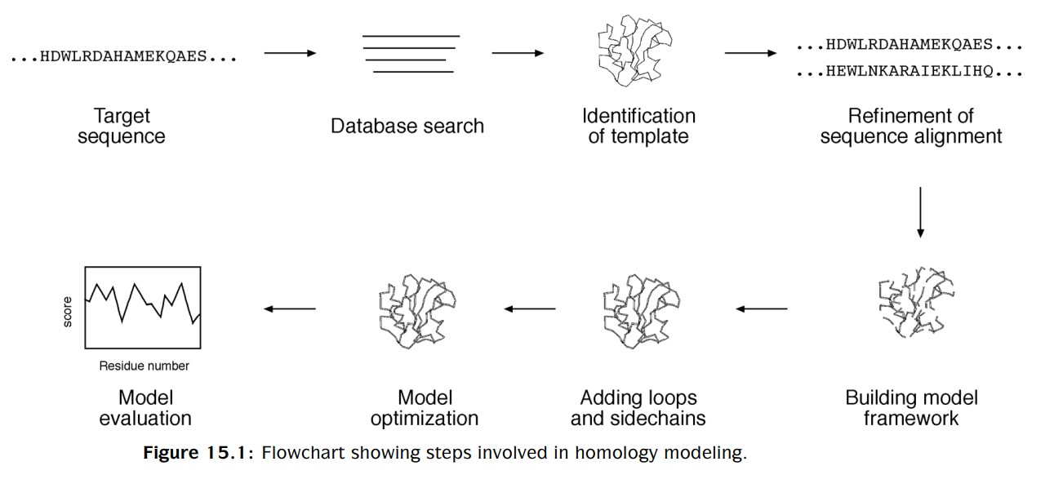

Slide 17
THREADING AND FOLD RECOGNITION
Threading or structural fold recognition predicts the structural fold of an unknown protein sequence by fitting the sequence into a structural database and selecting the best-fitting fold.
The algorithms can be classified into two categories,
pairwise energy based - - referred to as threading
profile based - - defined as fold recognition.
Note- However, the two terms are now often used interchangeably without distinction in the literature.

Slide 18
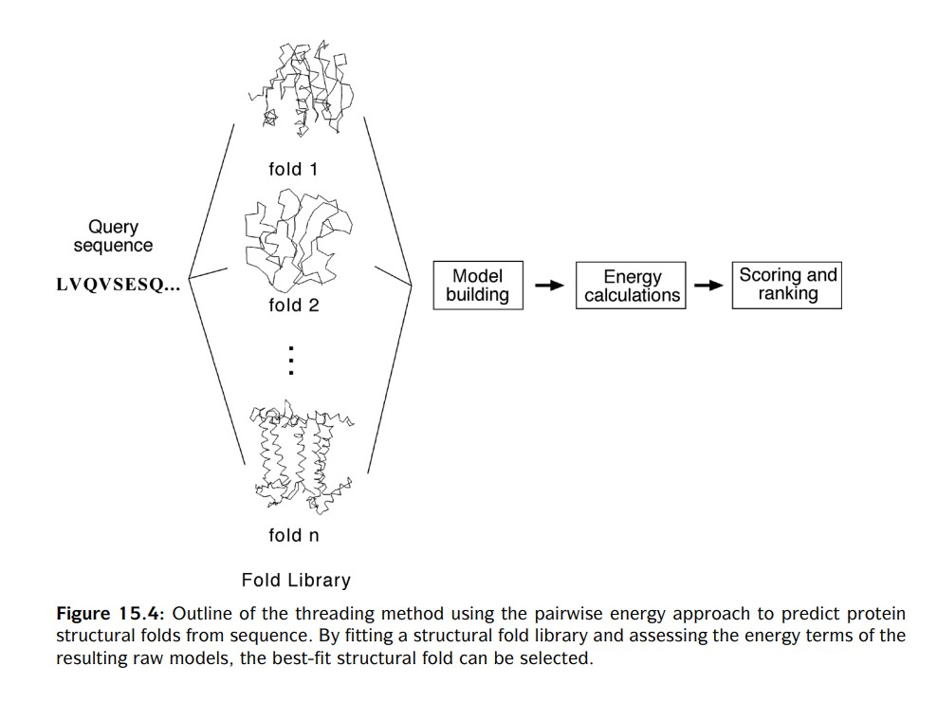
Pairwise energy method or threading

Slide 19
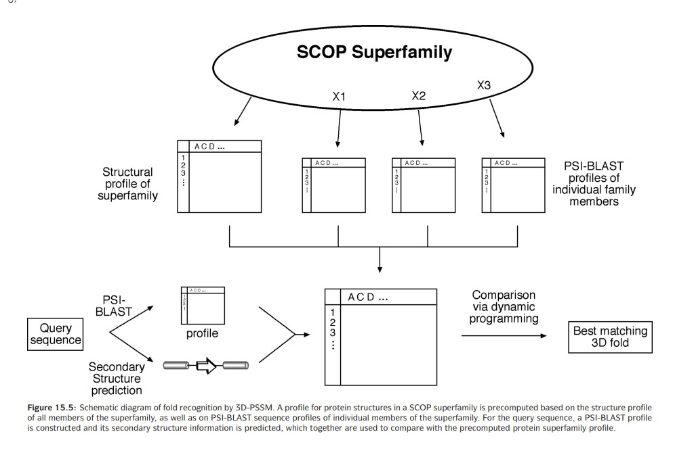
profile based or fold recognition

Slide 20
AB INITIO PROTEIN STRUCTURAL PREDICTION
Both homology and fold recognition approaches rely on the availability of template structures in the database to achieve predictions. If no correct structures exist in the database, the methods fail.
Studies have shown that most proteins fold spontaneously into a stable structure that has near minimum energy. This structural state is called the native state.
the ab initio prediction method – based on sequence information (without the aid of known protein structures)
advantage of this method-
predictions are not restricted by known folds and
that novel protein folds can be identified
Note- However, because the physicochemical laws governing protein folding are not yet well understood, the energy functions used in the ab initio prediction are at present rather inaccurate.

Slide 21
Methods | Database / web server
HOMOLOGY MODELING | ModBase , 3Dcrunch
THREADING AND FOLD RECOGNITION | 3D-PSSM, GenThreader, Fugue
AB INITIO PROTEIN STRUCTURAL PREDICTION | Rosetta, CASP (Critical Assessment of Techniques for Protein Structure Prediction)

Slide 22
Thank you

